Slide 1
Software Construction and Development
Spring 2026
M Khizar Hayat
Email: Khizerhayat@ucp.edu.pk
Office: Building D, 2nd floor
OFFICE HOURS: Fri (9:00 to 11:00)

Slide 2
Learning Outcomes
Define Software Construction
Differentiate between Software Construction and Software Development
Explain roles of Software Engineer vs Software Developer
Identify best practices in software construction
Understand software development process
Discuss real-world challenges

Slide 3
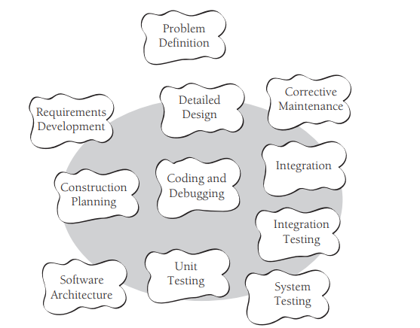
What is Software Construction?
According to Code Complete:
“Software Construction is the detailed creation of working, meaningful software through coding,
debugging, testing, and integration”.
It Includes:
Coding
Debugging
Unit Testing
Code Reviews
Integration
Figure 1-1 Construction activities are shown inside the gray circle. Construction focuses on coding and debugging but also includes detailed design, unit testing, integration testing, and other activities.

Slide 4
What is Software Development?
Software Development is the entire lifecycle of building software:
  Requirement Gathering
  System Analysis
  Design
  Implementation (Construction)
  Testing
  Deployment
  Maintenance

Slide 5
Example (University Portal System)
If UCP wants a Student Portal System:
Phase | Activity
Development | Gather requirements from registrar
Development | Design database
Construction | Write code in Java/PHP
Construction | Fix bugs
Development | Deploy on server

Slide 6
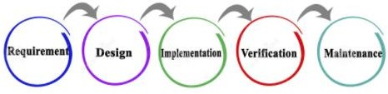
Introduction
Software Construction is the detailed creation of working software through a combination of coding, verification, unit testing, integration testing and debugging.
Construction uses the output from the design process to build
software therein described, and provides an output to testing

Slide 7
Relationship with other Knowledge areas
Although some detailed design may be performed prior to construction,
much design work is performed during the construction activity. Thus, the
Software Construction Knowledge area is closely linked to the Software Design Knowledge Area.
Throughout construction, software engineers both unit test and integration
test their work. Thus, the Software construction KA is closely linked to the Software Testing KA as well.
Software construction typically produces the highest number of
configuration items that need to be managed in a software project (source
files, documentation, test cases, and so on). Thus, the Software
Construction KA is also closely linked to the Software Configuration Management KA.

Slide 8
Importance of Software Construction
Construction is a large part of software development
Construction is the central activity in software development
With a focus on construction, the individual programmer’s productivity can improve enormously
Construction’s product, the source code, is often the only accurate description of the software
Construction is the only activity that’s guaranteed to be done

Slide 9
Software Engineer vs Software Developer
Software Engineer | Software Developer
Applies engineering principles | Implements features
Works on system architecture | Writes code
Focuses on scalability | Fixes bugs
Ensures quality and standards | Works on modules
Thinks long-term | Focuses on assigned tasks

Slide 10
Responsibilities – Software Engineer vs Software Developer
Responsibilities of Software Engineer | Responsibilities of Software Developer
Requirement analysis | Code implementation
System modeling | Debugging
Architecture design | Writing unit tests
Technology selection | Code documentation
Risk analysis | Version control handling
Performance optimization | Ensuring feature functionality

Slide 11
Best Practice for Software Engineer
Think before coding
Design for maintainability
Follow coding standards
Apply modular design
Conduct code reviews
Estimate realistically

Slide 12
Best Practice for Software Developer
Write readable code
Use meaningful variable names
Avoid duplicate code
Write small functions
Comment wisely
Test your own code
Notes:
int x;
int totalStudentCount;

Slide 13
Challenges of Software Engineers & Developers
Technical Challenges | Human Challenges
Changing requirements | Communication gaps
Tight deadlines | Team conflicts
Integration issues | Unrealistic expectations
Working with legacy systems | Client pressure
Performance constraints | Lack of stakeholder alignment
Notes:
Have you faced changing requirements in any of your projects?
What was the biggest challenge in coding your last project?
Did you ever redesign your code?

Slide 14
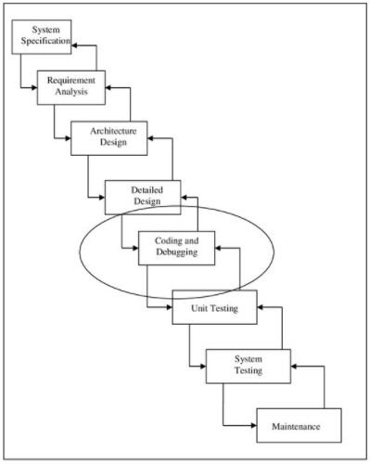
Software Development Activities/Process

Slide 15
Key Points
Software construction is the central activity in software development; construction is the only activity that’s guaranteed to happen on every project.
The main activities in construction are detailed design, coding, debugging, integration, and developer testing (unit testing and integration testing).
Other common terms for construction are “coding” and “programming.”
The quality of the construction substantially affects the quality of the software.
In the final analysis, your understanding of how to do construction determines how good a programmer you are, and that’s the subject of the rest of the book.

